Slide 1
Surface Energy and Thermodynamic Potentials*
February 17th, 2020
* Based on a presentation from the author´s book

Slide 2
Question…
Is it the same surface energy and surface tension?

Slide 3
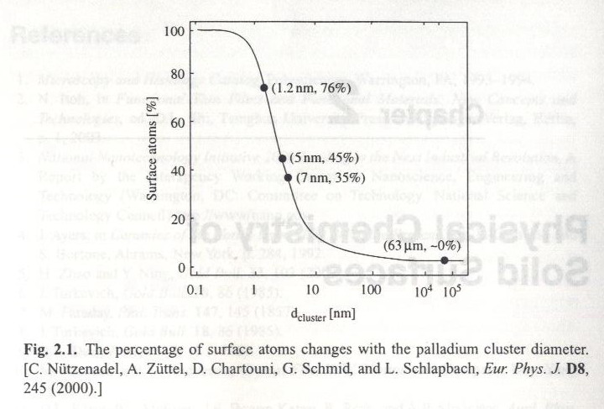
Percentage of surface atoms changes with cluster diameter

Slide 4
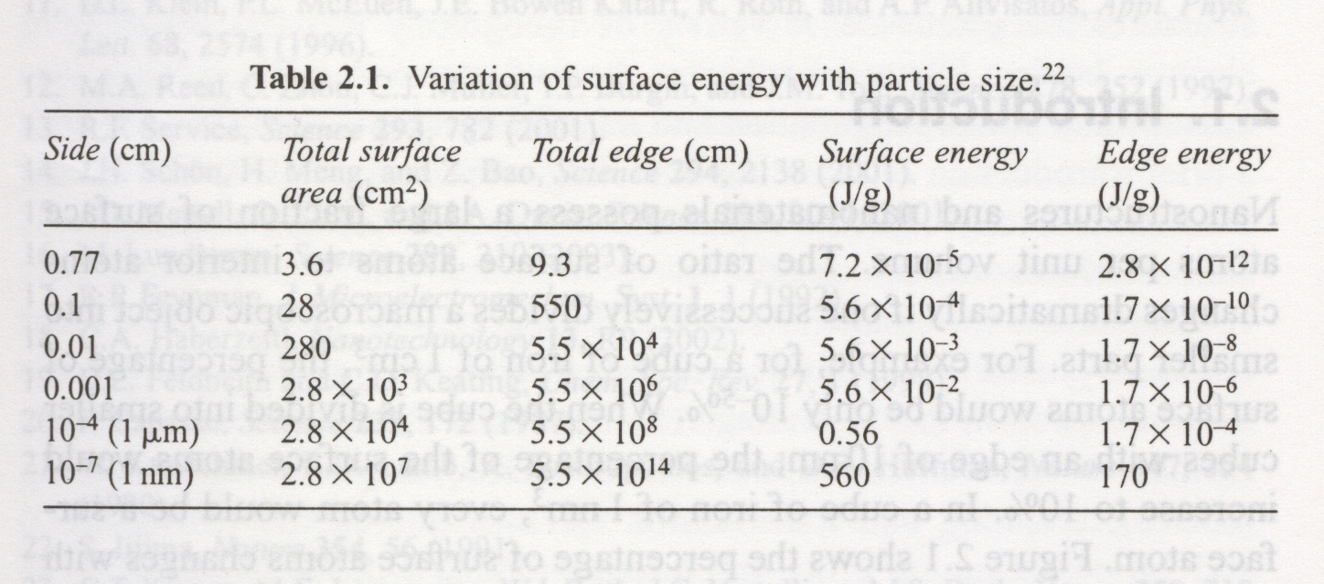
For 1 g of Sodium Chloride, the original 1 g cube is successively divided into smaller cubes.

Slide 5
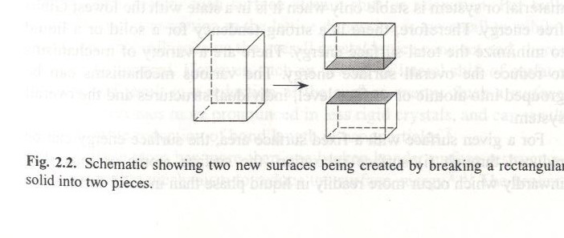
Comments:
Due to the vast surface area, all nanostructured materials possess a huge surface energy and, thus are thermodynamically unstable or metastable.
Goal: to overcome the surface energy, and to prevent the nanomaterials from growth in size, driven by the reduction of overall surface energy.

Slide 6
Surface Energy
Definition: energy required (or produced) to create a unit area of a new surface, therefore,
γ = (∂G/ ∂A)_{ni, T, P}
G: Gibs free energy of the surface
A: Surface area of the particles
Surface area can be increased by cutting a particle into two halves. The molecules of the newly created surface possess fewer nearest neighbors or coordination numbers, and thus have dangling or unsatisfied bonds. Due to the dangling bonds on the surface, surface atoms or molecules are under an inwardly directed force and the bond distance between molecules and the sub-surface molecules becomes smaller. An extra force or energy is required to pull the surface to its original positions.

Slide 7
Surface Energy
This energy is defined as surface energy, γ
γ = N_{b} ε ρ_{a} /2 = (∂G/ ∂A)_{ni, T, P}
N_{b}: number of broken bonds
ε: bond strength
ρ_{a} = number of atoms or molecules per unit surface area density
The above equation is very crude model and does not account for interactions between higher order neighbors.
γ_{la}

Slide 8
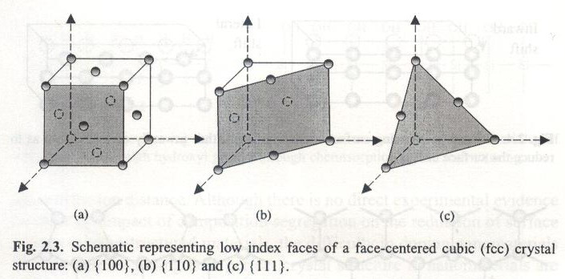

Slide 9
Surface Energy
For FCC structure with lattice constant a, each atom will have a coordination number 12, and each atom on the surface {100} has 4 broken bonds, on {110} 5 broken bonds and on {111} 3 broken bonds. Therefore,
γ = N_{b} ε ρ_{a} /2
γ_{{100}} = 2/a²．4．ε．1/2
γ_{{110}} = 2/2^{0.5}a²．5．ε．1/2
γ_{{111}} = 2/3^{0.5}εa²
If a=1, ε=1
γ_{{100}} = 4
γ_{{110}} = 3.52
γ_{{111}} = 1.16

Slide 10
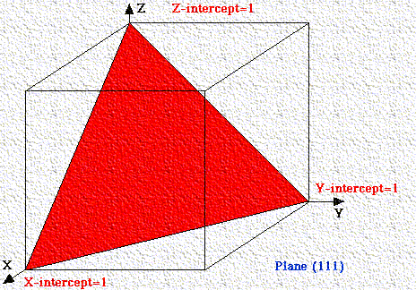
http://chemistry.bd.psu.edu/jircitano/Miller.html
According to Eqn (1), the lower Miller index facets have low surface energy. System is stable only when it is in a state with the lowest Gibbs free energy. Therefore, a crystal is often surrounded by low index surfaces.
http://cmacd.myweb.cs.uwindsor.ca/Teaching/553-class/59-553_Notes3.pdf
Notes:
Miller Indices
Miller Indices
Rules for Miller Indices: Determine the intercepts of the face along the crystallographic axes, in terms of unit cell dimensions.
Take the reciprocals
Clear fractions
Reduce to lowest terms
For example, if the x-, y-, and z- intercepts are 2, 1, and 3, the Miller indices are calculated as: Take reciprocals: 1/2, 1/1, 1/3
Clear fractions (multiply by 6): 3, 6, 2
Reduce to lowest terms (already there)
Thus, the Miller indices are 3,6,2. If a plane is parallel to an axis, its intercept is at infinity and its Miller index is zero. A generic Miller index is denoted by (hkl).
If a plane has negative intercept, the negative number is denoted by a bar above the number. Never alter negative numbers. For example, do not divide -1, -1, -1 by -1 to get 1,1,1. This implies symmetry that the crystal may not have!
Some General Principles
If a Miller index is zero, the plane is parallel to that axis.
The smaller a Miller index, the more nearly parallel the plane is to the axis.
The larger a Miller index, the more nearly perpendicular a plane is to that axis.
Multiplying or dividing a Miller index by a constant has no effect on the orientation of the plane
Miller indices are almost always small.
Why Miller Indices?
Using reciprocals spares us the complication of infinite intercepts.
Formulas involving Miller indices are very similar to related formulas from analytical geometry.
Specifying dimensions in unit cell terms means that the same label can be applied to any face with a similar stacking pattern, regardless of the crystal class of the crystal. Face 111 always steps the same way regardless of crystal system.
Movie of aminated gif above. Click the pause button, then step through the planes

Slide 11
Surface energy reduced by
Surface relaxation: surface atoms or ions shift inwardly.
Surface restructuring through combining surface dangling bonds into strained new chemical bonds
Surface adsorption through chemical or physical adsorption of terminal chemical species by forming chemical bonds or weak attraction forces such as electrostatic or van der Waals forces.
Composition segregation or impurity enrichment on the surface through solid-state diffusion.

Slide 12
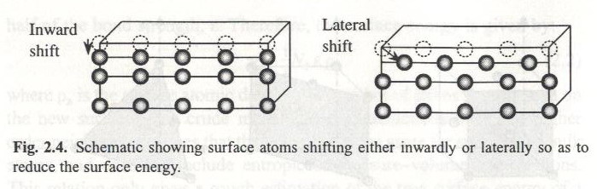
Surface energy reduction by surface relaxation

Slide 13
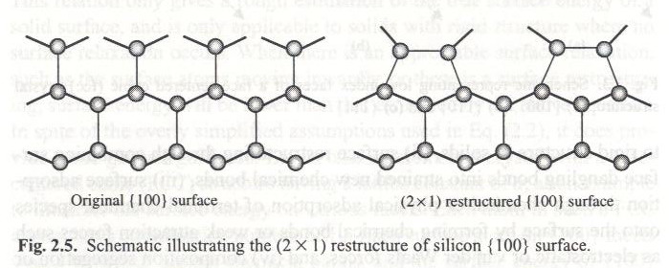
Surface energy reduction by restructuring
The restructured {100} faces have the lowest surface energy among {111}, {110} and {100} faces.

Slide 14
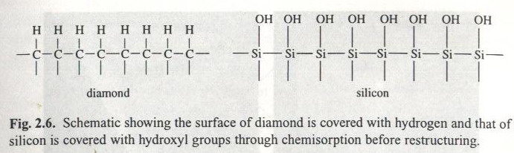
Surface energy reduction by chemical or physical adsorption

Slide 15
Surfaces…
…and you

Slide 16

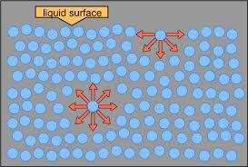
Importance of surfaces
What is a surface?
Surface structure
Surface processes
Surface interfaces
Surfaces in nature
Measuring surfaces
Modifying surfaces

Slide 17
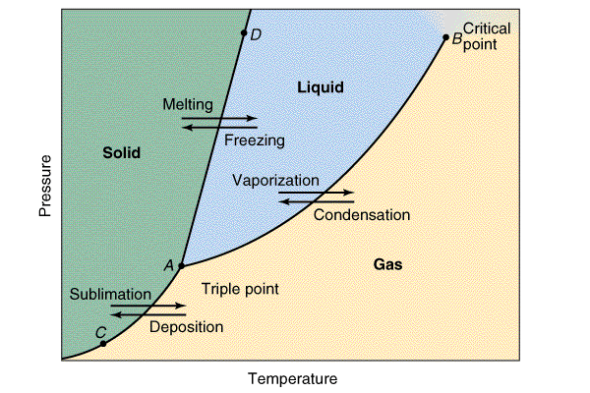
Surfaces Defined
Discontinuity between material phases:
Solid / air
Solid / liquid
Solid / solid
Liquid / air
Liquid / liquid
Liquid / solid
Molecules and colloids / particles have surfaces, surface charges, etc. This is what drives proteins to spontaneously fold (surface energy with water).
Surfaces exist at phases. Free energy must be minimized
Energy drives most surface reactions
Passivation
Oxidation
Adsorption of hydrocarbon and water
Reconstruction and reorientation

Slide 18
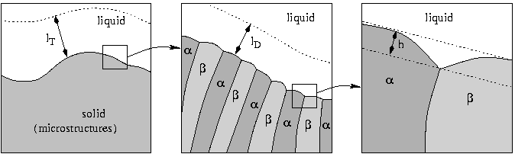
Heterogeneous Surface Structure
Different length scales involved during solidification. In the left image the thickness of the temperature diffusion layer (largest scale). In the middle image the mass diffusion layer is shown; at this scale the microstructures in the solid region can be seen. In the image at right the height deviations of the interface on the smallest scale.
http://www.uni-regensburg.de/Fakultaeten/nat_Fak_I/Mat8/lst/spp/projectSPP1095solidification.html

Slide 19
Real Surfaces Explained
Discontinuities create an interface
Dangling bonds, attractive / repulsive forces, unit cell cleavage planes
Interfaces often form passivation layers
Surfaces can scatter electrons
Materials can fail at interfaces
Can be cohesive / adhesive failures

Slide 20
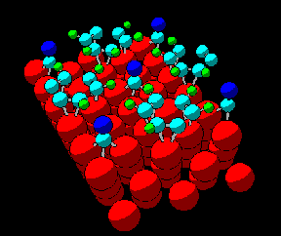
Surface Structure Database
The Surface Structure Database (SSD) is the only complete critical compilation of reliable crystallographic information now available on surfaces and interfaces. SSD brings instant access to detailed text and graphical displays of over 1250 experimentally-determined atomic-scale structural analyses.
http://www.nist.gov/srd/nist42.htm

Slide 21
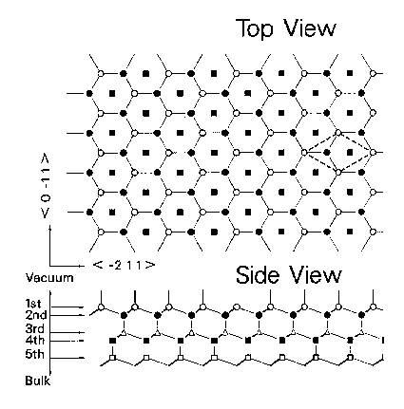
Silicon Surface Planes
Model of the ideal surface for Si{111}1x1. The open and closed circles represent Si atoms in the first and second layers, respectively. Closed squares are fourth-layer atoms exposed to the surface though the double double-layer mesh. The dashed lines indicated the surface 1x1 unit-cell.
http://www.matscieng.sunysb.edu/leed/trunc.html

Slide 22
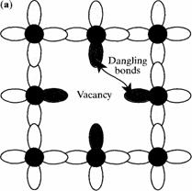
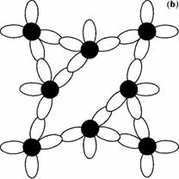
Si Surface Reconstruction
Schematic diagram of a covalent semiconductor with (a) an unrelaxed vacancy involving four dangling bonds and (b) a relaxed vacancy with no dangling bonds http://www.mtmi.vu.lt/pfk/funkc_dariniai/sol_st_phys/defects.htm

Slide 23
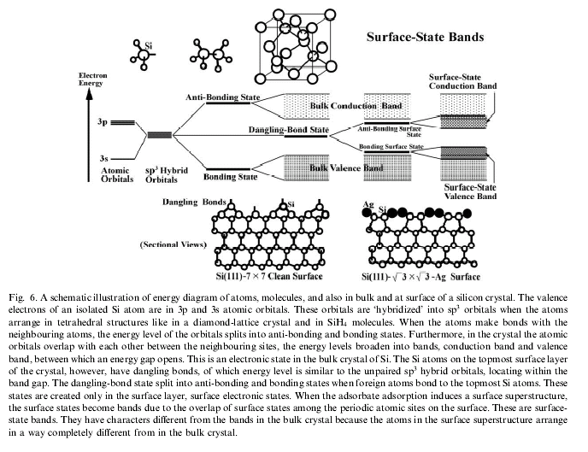

Slide 24
Surface Processes
Passivation
Oxide formation
Adventitious carbon
Reconstruction
Crystalline
Polymer orientation
Adsorption of gases and water vapor
Both can lead to surface passivation

Slide 25
Surface Free Energy
The net effect of this situation is the presence of free energy at the surface. The excess energy is called surface free energy and can be quantified as a measurement of energy/area. It is also possible to describe this situation as having a line tension or surface tension which is quantified as a force/length measurement. Surface tension can also be said to be a measurement of the cohesive energy present at an interface. The common units for surface tension are dynes/cm or mN/m. These units are equivalent. Solids may also have a surface free energy at their interfaces but direct measurement of its value is not possible through techniques used for liquids. Polar liquids, such as water, have strong intermolecular interactions and thus high surface tensions. Any factor which decreases the strength of this interaction will lower surface tension. Thus an increase in the temperature of this system will lower surface tension. Any contamination, especially by surfactants, will lower surface tension. Researchers should be very cautious about the issue of contamination. http://www.ksvinc.com/surface_tension.htm

Slide 26
Surface Energetics
The unfavorable contribution to the total (surface) free energy may be minimized in several ways:
By reducing the amount of surface area exposed – this is most common / fastest
By predominantly exposing surface planes which have a low surface free energy
By altering the local surface atomic geometry in a way which reduces the surface free energy

Slide 27
How do Molecules Bond to Surfaces?
There are two principal modes of adsorption of molecules on surfaces:
Physical adsorption ( Physisorption )
Chemical adsorption ( Chemisorption )
The basis of distinction is the nature of the bonding between the molecule and the surface. With:
Physical adsorption : the only bonding is by weak Van der Waals - type forces. There is no significant redistribution of electron density in either the molecule or at the substrate surface.
Chemisorption : a chemical bond, involving substantial rearrangement of electron density, is formed between the adsorbate and substrate. The nature of this bond may lie anywhere between the extremes of virtually complete ionic or complete covalent character.
http://www.chem.qmul.ac.uk/surfaces/scc/

Slide 28
Adsorption / Self Assembly Processes on Surfaces
Physisorption
Physical bonds
Chemisorption
Chemical bonds
Self-Assembled Monolayers (SAMs)
Alkane thiols on solid gold surfaces
Self assembly of monolayers

Slide 29
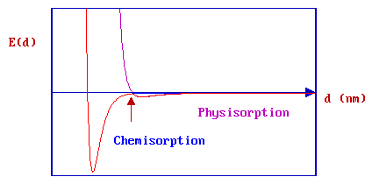
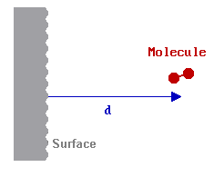
Chemi / Physi - Adsorption
The graph above shows the PE curves due to physisorption and chemisorption separately - in practice, the PE curve for any real molecule capable of undergoing chemisorption is best described by a combination of the two curves, with a curve crossing at the point at which chemisorption forces begin to dominate over those arising from physisorption alone. The minimum energy pathway obtained by combining the two PE curves is now highlighted in red. Any perturbation of the combined PE curve from the original, separate curves is most likely to be evident close to the highlighted crossing point.
http://www.chem.qmul.ac.uk/surfaces/scc/scat2_4.htm

Slide 30
Forces at Interfaces
Van Der Val's forces
Surface tension
Interfacial bonding
Hydrophobic / hydrophilic interactions
Surface reconstruction / reorientation
Driven by, or are part of ‘excess surface free energy’ which must be minimized.

Slide 31
Importance of Interfaces
Chemical reactions occur at interfaces
Particularly corrosion
Scattering energy
Electrons
Light
Phonons
An interface is actually two surfaces

Slide 32
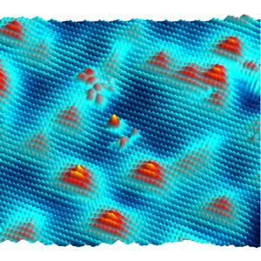
Constant current STM image of a GaAs (110) surface
Constant current STM image of a GaAs (110) surface highly doped with Zn acceptors at T = 4.7 K. The acceptors appear as triangle features. Both gallium (light blue to yellow) and arsenic (dark blue) atoms are observed. (sample voltage : +1.6 V current, : 80 pA).
http://www.omicron.de/index2.html?/rom/coloured_sem_images/~Omicron

Slide 33
Defects at Interfaces
Missing atoms
Defects and holes
Extra atoms
Surface segregation
Dangling bonds
Disrupted electronic properties
Dimensional issues
Lattice mismatch / shelves

Slide 34
Cohesive / Adhesive Failure at Interfaces
Cohesive failure occurs within a layer
It can be from material weakness
Or simply less strong than adhesion
Adhesive failure occurs between layers
It can arise form contamination, or poor adhesion, or simply the strength of adhesion was greater than the material

Slide 35
Cohesive Failure
Material A
Material B
Material fails cohesively within B
Material B

Slide 36
Adhesive Failure
Material A
Material fails adhesively between A and B
Material B

Slide 37
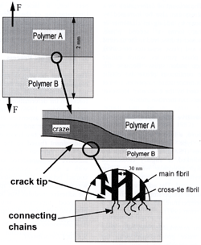
Adhesive Failure (Craze)
Schematic representation of the structure at the crack tip in a crazing material are shown at three length scales. It is assumed that only material A crazes. The whole of the craze consists of lain and cross-tie fibrils.
http://www.azom.com/details.asp?ArticleID=2089

Slide 38
Surface Reactions
Oxidation
Surface diffusion
Diffusion and oxidation
Adventitious carbon bonding
Hydrocarbons from the atmosphere
Surface rearrangement
Polymers may reorient to minimize energy

Slide 39
A Typical Surface
Hydrocarbon layer of about 15 to 20 Angstroms
Oxide layer of about 15 to 20 Angstroms
Solid material like silicon or aluminum
Hydrocarbons and water rapidly adsorb to a metal or
Silicon surface. Oxides form to a thickness of about 15
To 20 Angstroms, and hydrocarbons to a similar thickness.
This is part of the normal surface passivation process.

Slide 40
Reduction of surface energy for a nanoparticle:
One is to reduce the total surface area. That is, surface tends to become spherical.
For crystalline particle, facets forms because they have smaller surface energy than a spherical surface does. Since facets with a lower Miller Index have a lower surface energy than that with a higher Miller Index. Therefore, crystal is often surrounded by low index surfaces.

Slide 41
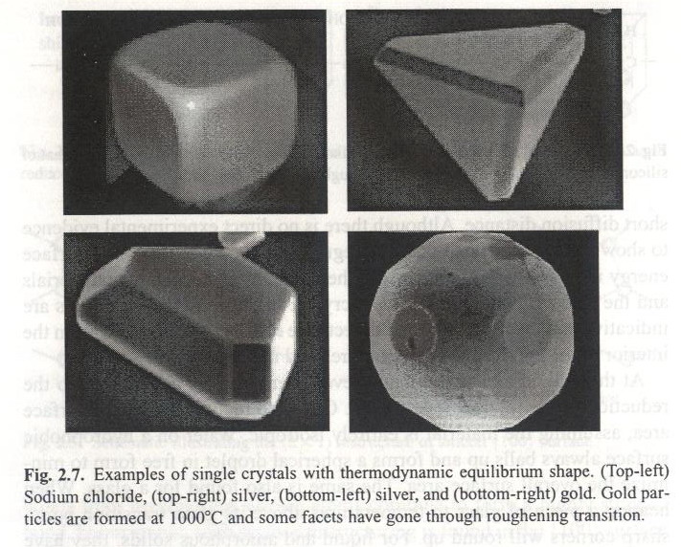

Slide 42
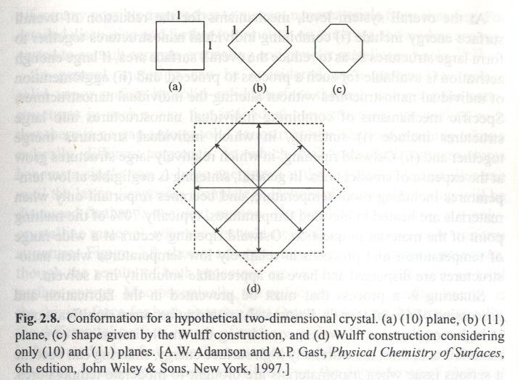
Wulff plot: using γ_{i} = Ch_{i} where C is the constant and h_{i} is the perpendicular distance.

Slide 43
Crystal Grown with Nonfacets
At certain high temperature, the equilibrium crystal surfaces may not be smooth, and difference in surface energy of various crystal facets may disappear. Such a transition is called surface roughening or roughening transition. Most nanoparticles grown at elevated temperature are spherical in shape (not facets).
Kinetic factors (processing or crystal growth conditions) may also prevent formation of facets.

Slide 44
Mechanisms for reduction of overall surface energy
Combining individual nanostructures together to form large structures so as to reduce the overall surface area, which includes:
Sintering: individual structures merge together which occurs at 70% of T_{m}. Replacing solid-vapor interface by solid-solid interface and becomes polycrystalline.
Ostwald ripening: A large one grows at the expense of the smaller one until the latter disappears completely, and becomes a single crystal. It occurs at relatively low temperature.
Agglomeration of individual nanostructures through chemical bonds and physical attraction forces at interfaces without altering the individual nanostructures. The smaller the particles, the greater the bonding forces are.

Slide 45
Thermodynamic potentials
Thermodynamic potentials are state functions that, together with the corresponding equations of state, describe the equilibrium behavior of a system as a function of so-called ”natural variables”. The natural variables are a set of appropriate variables that allow to compute other state functions by partial differentiation of the thermodynamic potentials.
Source: https://itp.uni-frankfurt.de/~gros/Vorlesungen/TD/5_Thermodynamic_potentials.pdf

Slide 46
Review
The Laws of Thermodynamics
https://www.youtube.com/watch?v=8N1BxHgsoOw
Thermodynamic Potentials Part 1
https://www.youtube.com/watch?v=EgbrBJ3-OH4
Thermodynamic Potentials Part 2
https://www.youtube.com/watch?v=VVDaR6oczJU

Slide 47
Thermodynamic equations
Name
Formula
Fundamental equations
Variables
Internal Energy
(depends on the system)
Helmotz Free Energy
Enthalpy
Gibbs Free Energy
Landau
Potential
Where: T= temperature, S= enthropy, P= pressure, V=Volume, N_{i} is the number of particles and μ is the chemical potential

Slide 48
Helmholtz free energy is often represented by F (particularly in physics), although IUPAC prefers the symbol A (which is used primarily in chemistry).
It can be shown that the knowledge of one of the thermodynamic potentials based on their natural variables allows obtaining all the thermodynamic variables of the system. This is possible by using the four Maxwell relationships for thermodynamics, partial derivative equations that relate state variables to thermodynamic potentials.
Each thermodynamic potential, under this point of view, is not only a physical quantity to which a value (real number) that we can eventually measure, but more properly must be seen as a mathematical functional dependence, which contains all the information of the system.
This is why we talk about the "natural variables" of each potential: they are the magnitudes that play the role of independent variables in the function associated with the potential

Slide 49
Chemical Potential and Surface Tension
NOTE: Here Omega is the atomic volume not the Landau Potential
Flat surface
NOTE: Miu is the chemical potential
gamma is the surface energy
n is the number of particles
Migration of chemical species from a flat surface to a spherical particle
Similar to the Young-Laplace eqn
(1)

Slide 50
Chemical Potential and Surface Tension
P_{infinte} is the equilibrium vapor pressure of the flat surface
Pc is the equilibrium vapor pressure of the curved surface
Chemical potential of the convex surface
Chemical potential of the flat surface
Δμ=
Flat surface
Flat surface
Evaporation of an atom form from a flat surface to the environment
If we combine with equation 1 from the previous slide:
Evaporation of an atom form from a flat surface to the environment
For a spherical particle
The vapor pressure of the particle increases as the radius of the particle
decreases

Slide 51
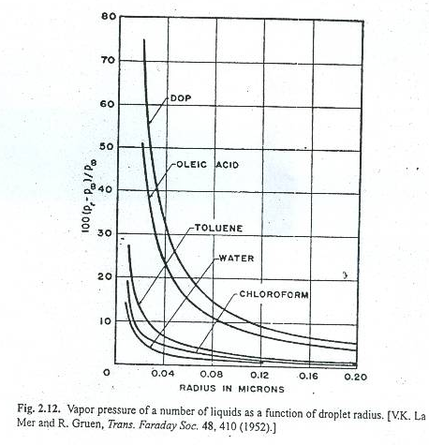
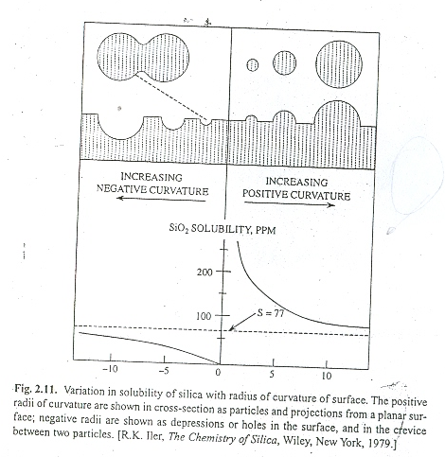
Chemical potential and its effect on vapor pressure
Chemical potential and its effect on solubilty
Similarly, for solubility:
S_{c}
S∞
Let us discuss these behaviors

Slide 52
Modeling size effects on the surface free energy of metallic nanoparticles and nanocavities
Shiyun Xiong,ª Weihong Qi,*^{ab} Yajuan Cheng,ª Baiyun Huang,^{c} Mingpu Wang^{ab} and Yejun Liª ; Physical Chemistry Chemical Physics Journal, Issue 2, 2011
https://pubs.rsc.org/en/content/articlelanding/2011/cp/c0cp02102d#!divAbstract
Notes:
Abstract
Based on the rigorous consideration of the bond broken rule and surface relaxation, a model for the size-dependent surface free energy of face-centered-cubic nanoparticles and nanocavities is presented, where the surface relaxation is calculated by the BOLS relationship. It is found that the surface free energy of nanoparticles and nanocavities represents a reverse size effect—the surface free energy of nanoparticles decreases with the decrease of particle size while it rises with the shrinkage of cavities. The size effect on the surface free energy of nanoparticles and nanocavities is not evident in large size ranges, while it becomes more and more distinct with decreasing size, especially for sizes smaller than 10 nm. The present predictions are in good agreement with the available literature data.

Slide 53
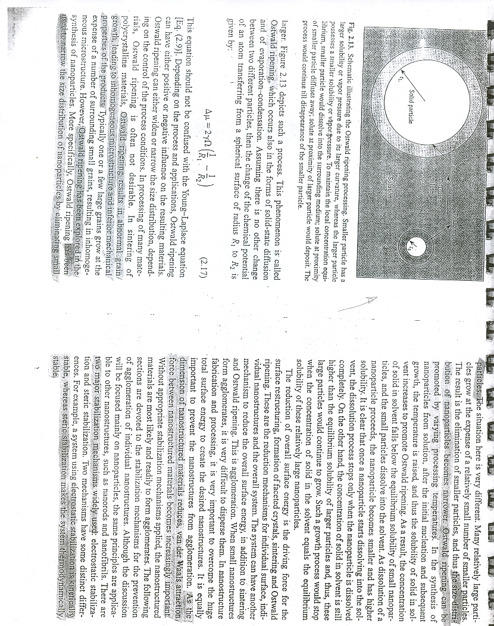
Ostwald Ripening Phenomenon

Slide 54
Surface stress and surface energy of Al nanoclusters computed based on DFT calculation. The surface energy/stress-particle radius curves were drawn based on the data presented in ref. 29.
Wu, Jianbo & li, Panpan & Pan, Yung-Tin & Warren, Steven & Yin, Xi & Yang, Hong. (2012). ChemInform Abstract: Surface Lattice-Engineered Bimetallic Nanoparticles and Their Catalytic Properties. Chemical Society reviews. 41. 10.1039/c2cs35189g.
Notes:
Abstract
When nanoparticles become small (ca. <5 nm), surface stress becomes significant and generates strain that results in a change of surface structures. In this regard, the surface lattice of nanoparticles can be engineered to create strains or other structural changes with atomic positions away from the normal lattice points. Such changes impact the electronic and catalytic properties of nanoparticles. Recently, several groups have reported the change of catalytic and electrocatalytic properties of bimetallic nanoparticles. In this tutorial review, we discuss the principles related to lattice strain and other distorted structures, and the catalytic properties of bimetallic nanostructures.

Slide 55
Paper for Discussion
Surface Tension, Surface Energy, and Chemical Potential Due to Their Difference
https://pubs.acs.org/doi/abs/10.1021/la400937r

Slide 56
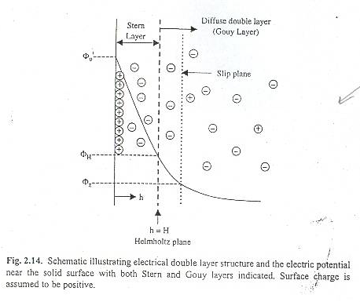
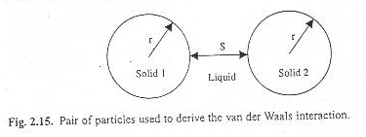
Electric potential at the proximity of solid surface

Slide 57
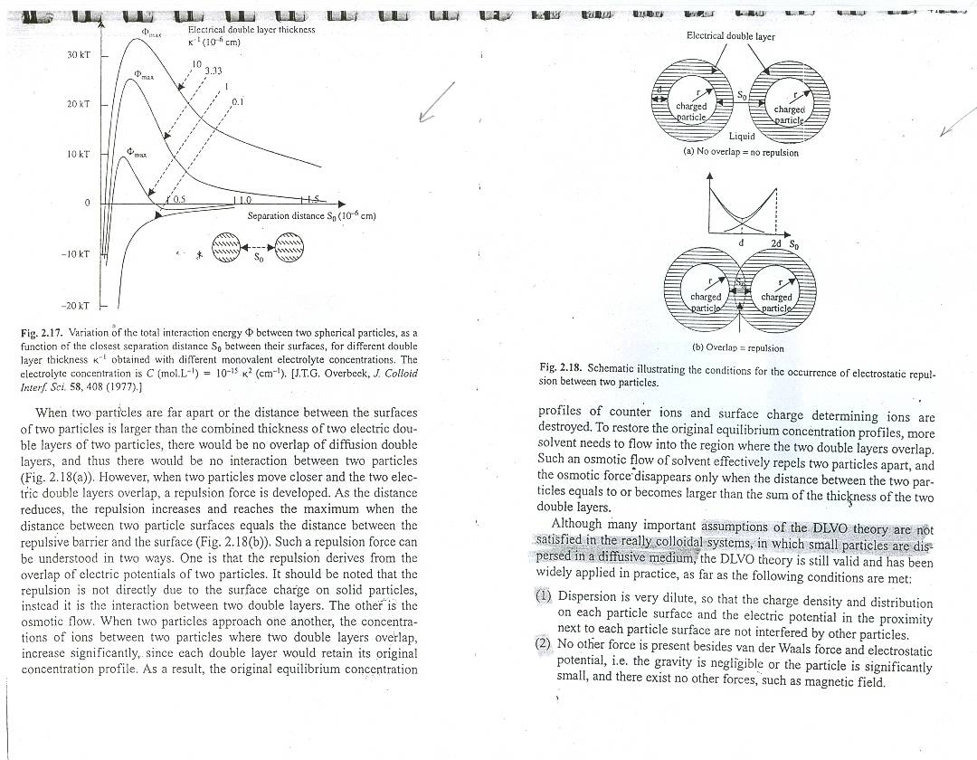
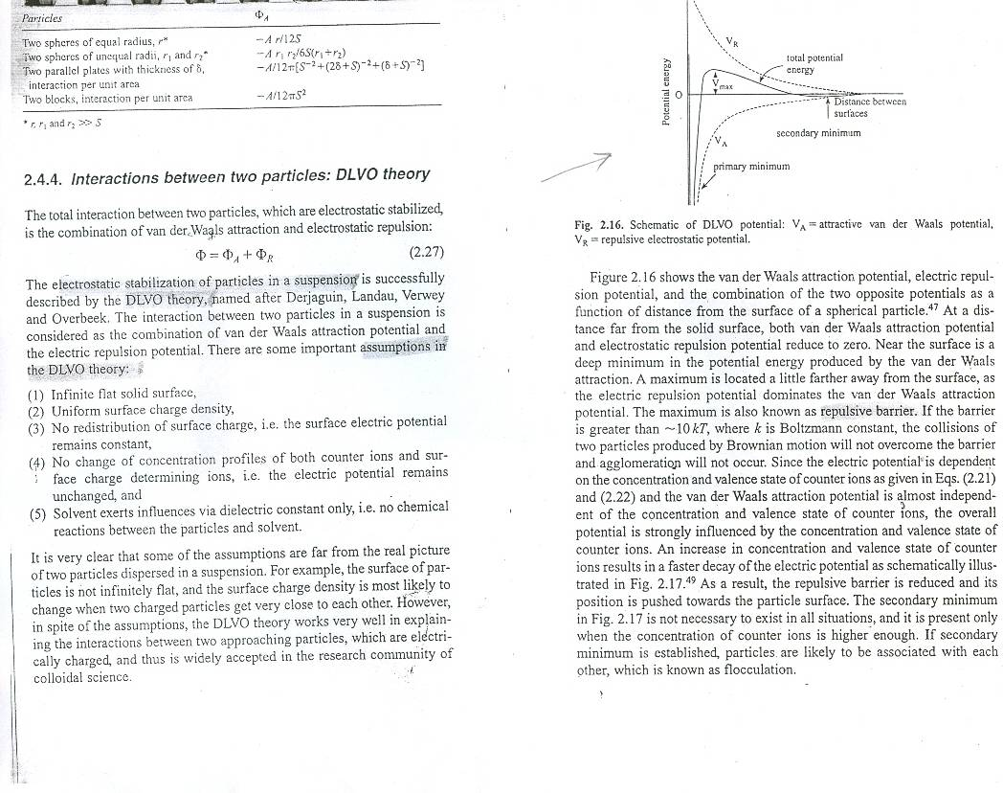
Interactions between 2 particles : DLVO Theory

Slide 58
Interactions between 2 particles : DLVO Theory

Slide 59
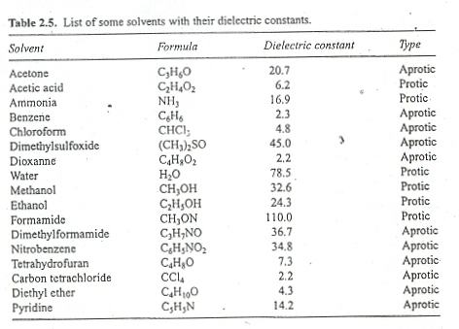
Steric stabilization: solvent and polymer

Slide 60
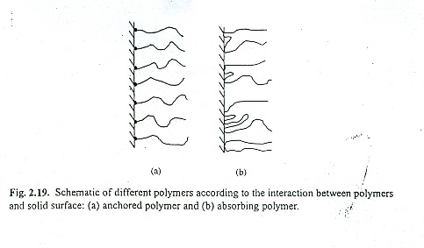
Steric stabilization: solvent and polymer

Slide 61
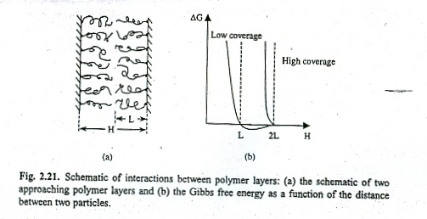
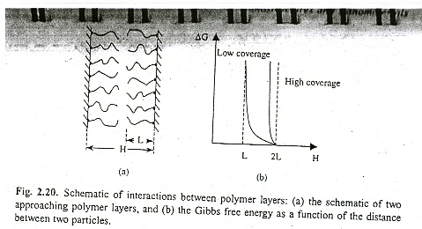
Steric stabilization: solvent and polymer

Slide 62
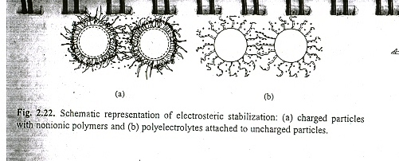
Steric stabilization: mixed steric and electric interactions

